Slide 1
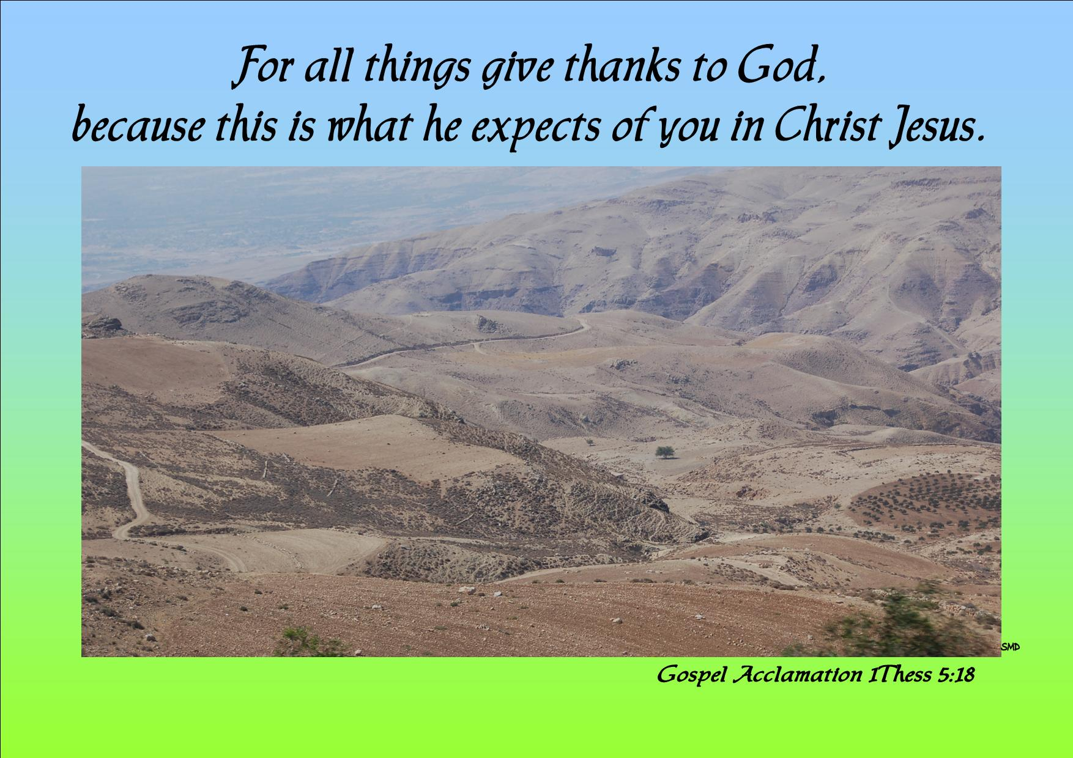
Welcome to St Michael’s
28th Sunday in Ordinary Time Year C
Please ensure all mobile phones are switched off.
Please be respectfully quiet as we prepare for our Celebration.
Notes:
Saturday 5.30PM First Sunday of Advent
7am - 22nd Sunday in Ordinary Time

Slide 2
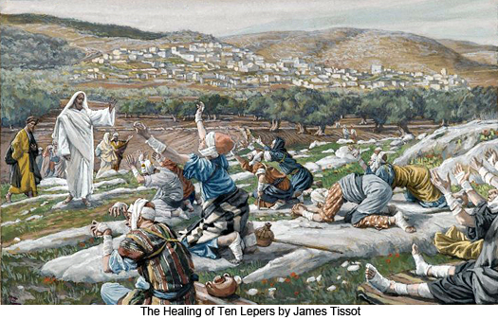
As Jesus entered one of the villages, ten lepers came to meet him…

Slide 3
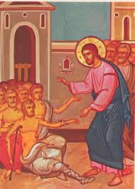
They called to him,
‘Jesus! Master! Take pity on us.’

Slide 4
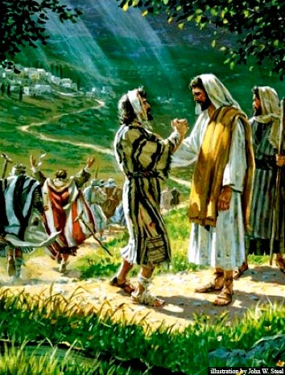
Finding himself cured, one of them turned back praising God at the top of his voice and thanked Jesus.

Slide 5

As I come to the table of the Lord I give thanks for …

Slide 6
PLEASE STAND

Slide 8
Glory to God in the highest,
and on earth peace to people of good will. We praise you, we bless you,
we adore you, we glorify you,

Slide 9
we give you thanks for your great glory,
Lord God, heavenly King,
O God, almighty Father.

Slide 10
Lord Jesus Christ, Only Begotten Son,
Lord God, Lamb of God, Son of the Father,

Slide 11
you take away the sins of the world, have mercy on us;
you take away the sins of the world, receive our prayer;

Slide 12
you are seated at the right hand of the Father,
have mercy on us.

Slide 13
For you alone are the Holy One,
you alone are the Lord, you alone are the Most High, Jesus Christ, with the Holy Spirit, in the glory of God the Father. Amen.

Slide 15
RESPONSORIAL PSALM
The Lord has revealed to the nations his saving power.

Slide 17
GOSPEL ACCLAMATION
Alleluia, alleluia!
For all things give thanks to God,
because this is what he expects of you in Christ Jesus.
Alleluia!

Slide 19
Apostles Creed
I believe in God,
the Father almighty,
Creator of heaven and earth,
and in Jesus Christ, his only Son, our Lord,
(At the words that follow, up to and including the Virgin Mary, all bow.)

Slide 20
who was conceived by the Holy Spirit,
born of the Virgin Mary,
suffered under Pontius Pilate,
was crucified, died and was buried;
he descended into hell;

Slide 21
on the third day he rose again from the dead;
he ascended into heaven,
and is seated at the right hand of God the Father almighty;
from there he will come to judge the living and the dead.

Slide 22
I believe in the Holy Spirit,
the holy catholic Church,
the communion of saints, the forgiveness of sins,
the resurrection of the body, and life everlasting. Amen.

Slide 24
First Collection
This collection goes to the Bishop
for the support of the Diocese.
Thank you for your contribution

Slide 26
All: May the Lord accept the sacrifice
at your hands for the praise and glory of his name, for our good and the good of all his holy Church.

Slide 28
HOLY, HOLY, HOLY
Holy, Holy, Holy Lord God of hosts,
Heaven and earth are full of your glory. Hosanna in the highest
Blessed is he who comes
in the name of Lord,
Hosanna in the highest.

Slide 30
Save us, Saviour of the world,
for by your Cross and Resurrection
you have set us free.
Memorial Acclamation
We proclaim your Death, O Lord,
and profess your Resurrection
until you come again.
When we eat this Bread
and drink this Cup,
we proclaim your Death, O Lord,
until you come again.
Notes:
Sunday 10AM First Sunday of Advent
7am - 14th Sunday in Ord Time
7am - 14th Sunday in Ord Time

Slide 32
Lamb of God
Lamb of God, you take away the sins of the world, have mercy on us.
Lamb of God, you take away the sins of the world, have mercy on us.
Lamb of God, you take away the sins of the world, grant us peace.

Slide 34
All: Lord, I am not worthy
that you should enter under my roof, but only say the word
and my soul shall be healed.

Slide 35


Slide 36
Second Collection
What you contribute now
is for the support of our
parish and its mission.
Thank you for your generosity

Slide 37

eConference: Gospel of John
Wednesday 16 October
Institute for Mission Blacktown
10:00am – 3:00pm
Tea/Coffee provided - Bring your own lunch!
Bookings mh@instituteformission.com.au - 9831 4911

Slide 38

PPC MEETING
(Parish Pastoral Council)
Tuesday 22 October 7.30PM
Parish Centre
All Welcome!

Slide 39

The SVDP pantry needs to restock the following items:
Pasta Sauce; Tinned Fruit; Tinned Meat (Corned Beef/Ham) Tinned Spaghetti and Biscuits.
Many thanks for your support

Slide 40

Please take home your bulletins or download it from
www.stmichaelsparish.com
  www.facebook.com/
  blacktowncatholics

Slide 42
As I come to the table of the Lord I give thanks for …

